Slide 1
Array
Pro Academy I
Data Structure
Notes:
By leonardi.l

Slide 2
Definition
Array store homogeneous elements at contiguous locations
Size of the array is fixed at creation time
Elements can be random-accessed by its index

Slide 3
Speed
Access | O(1) | If the index is known
Search | O(n) | for sequential search
 | O(log n) | for Binary Search (data is sorted)
Insertion | O(n) | worst case : insert at beginning, shift all of the previous elements
Deletion | O(n) | worst case : delete at beginning, shift all of the remaining elements

Slide 4
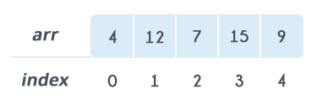
1D Array
// Array declaration and initialization
int arr[5] = {4, 12, 7, 15, 9};
// Iterate over the array
for (int idx = 0; idx < 5; idx++) {
// Print out each element in a new line
cout << arr[idx] << endl;
}

Slide 5
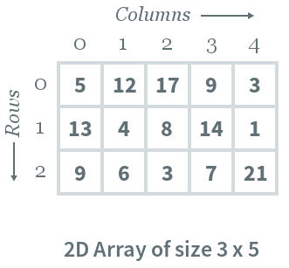
2D Array
// Array declaration and initialization
int arr[3][5] = {
{5, 12, 17, 9, 3},
{13, 4, 8, 14, 1},
{9, 6, 3, 7, 21}};
// Iterate over the array
for(int i=0; i<3; i++) {
for(int j=0; j<5; j++)
cout << arr[i][j];
cout << endl;
}

Slide 6
When to use Array
Total element needed is known
Element relations is contiguous (no need to create separate variable for every elements)
Element are indexed by nature ()

Slide 7
Exercise : Transpose
Given a 2D array A, your task is to convert all rows to columns and columns to rows.
Input: First line contains 2 space separated integers, N - total rows, M - total columns. Each of the next N lines will contain M space separated integers.
Output: Print M lines each containing N space separated integers.
Notes:
Constraints: 1≤N≤10 1≤M≤10 0≤A[i][j]≤100 where 1≤i≤N and 1≤j≤M
SAMPLE INPUT
3 5
13 4 8 14 1
9 6 3 7 21
5 12 17 9 3
SAMPLE OUTPUT
13 9 5
4 6 12
8 3 17
14 7 9
1 21 3

